Slide 1
INM707 DEEP REINFORCEMNT LEARNING Oral Presentation
COURSEWORK:
https://github.com/vivekkanna26/INM707-DEEP-REINFORCEMNT-LEARNING
Vivek Kanna Jayaprakash
Student No : 210033212
MSc Data Science City University of London
London, United Kingdom
Email : Vivek.Jayaprakash@city.ac.uk

Slide 2
Parts of the presentation
1.Q learning
2.DQN with 2 improvements
3.RL algorithm in ATARI environments.
4.PPO

Slide 3
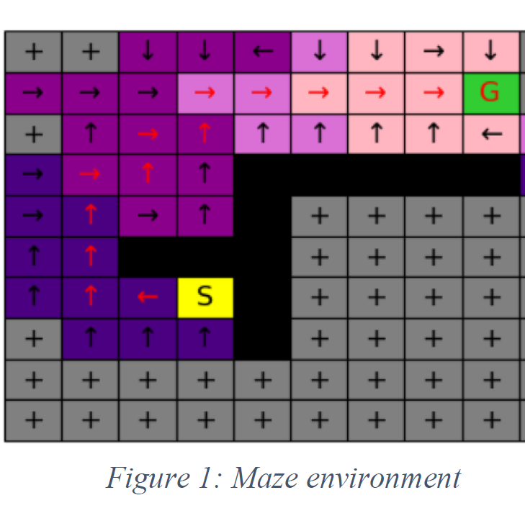
Q-Learning
In this project we are attempting to use reinforcement learning techniques to teach automatic warehouse robot within an E-commerce website company’s warehouse to pick items and deliver the same to the inputted goal or designated delivery location in a maze.
We use Deep reinforcement learning techniques to find the shortest path for the robots to pick up the goods from the required square and deliver them to their desired packing location in the same warehouse so the items can be packed and shipped.
MAZE Environment.

Slide 4
State transition function
A state transition function δ. The state transition function says how the state machine changes state in response to an event. If the machine is in state s, and it receives an event e, then the new state of the machine will be s' = δ(s,e). Often the state transition function is allowed to return a special value that is not a state, to indicate that there is no next state.
For this problem the agents will interact with the environment on a continues basis and keeps on its process of knowledge adaptation for the entire maze and also updates the knowledge of the policy. And thereby reaches a goal of achieving the maximum reward.
The path to reach the goal is the learning curve in which the agent aims to achieve and also making sure it doesn’t crash into the said obstacles. The optimal path is identified by the entering point to the goal by continuously maximising the reward set up and minimising the punishments set up.
The environment consist of states, actions and rewards in which the states and actions are the considered input for the Q learning atmosphere In this problem the states are the entire blocks of the maze, there are four possible action (left, right, down and up) The agent can take any significant action to reach the goal provides it the shortest path and it doesn’t crash in tot eh terminal back squared chequered block.

Slide 5
Reward function
In our experiment the reward function is not identified at the beginning but the agent will identify the same once it moves from one block to another on the set of scale. Thereby the required function clearly fully explores and covers the environment for learning the reward.
The black boxes are all terminal states having (minus) -100 as reward in which we teach to agent to not crash into them.
The non-black boxes are set with reward as -1 in this case as our goal is to minimise the punishments and to identify the shortest way to the desired goal box. The reward is set to be -1 and not 1 because the agent should not keep rotating and travelling up in them boxes thereby increasing its rewards.
The rewards, punishments are set up automatically by the said maze environment.
The maximum cumulative reward thereby minimizing its cumulative punishments makes the agent need to find the shortest path to the packaging goal area are where the reward is set to 100
R(s) = R(s) +alpha (r- R(s))
Alpha = learning rate
R = immediate reward.
This type of immediate learning is required because it uses the learning has a serious effect on it next action.

Slide 6
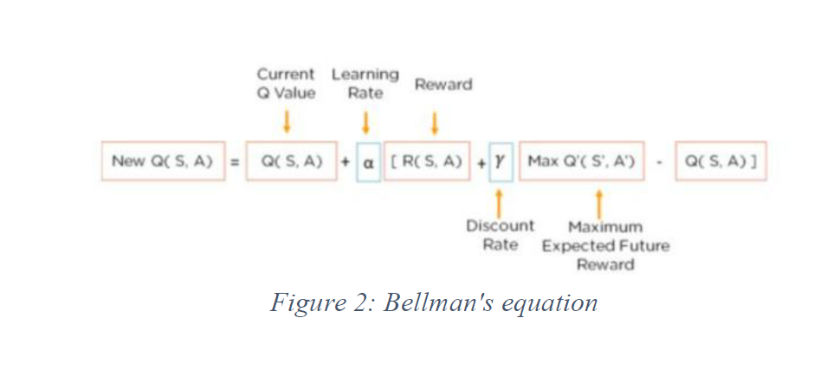
Set up Q learning parameters
Q() = Q learning algorithm
S is the previous state
A is the previous action
S’ = current state
α – alpha or learning rate where learning rate (0-1) is the rate of much in which the state accept the new value in continuation of the old value. Takes in previous q values and movies it to the upside
ϓ = gamma or discount factor (0-1) is used to get a good balance between the immediate and future reward. We can only apply discount to the future reward.

Slide 7

Policy
Policy - Epsilon greedy function :
Epsilon greedy is very early iterative method to balance exploration and exploitation by choosing between them randomly.
Exploration make the agent improve the current knowledge on every said action to make sure the long view goal advantage meanwhile the exploitation being the greedier one chooses the best action using the states current action value estimates.
The agent will always choose the random state until otherwise the greedy action is greater than its parametric epsilon.

Slide 8
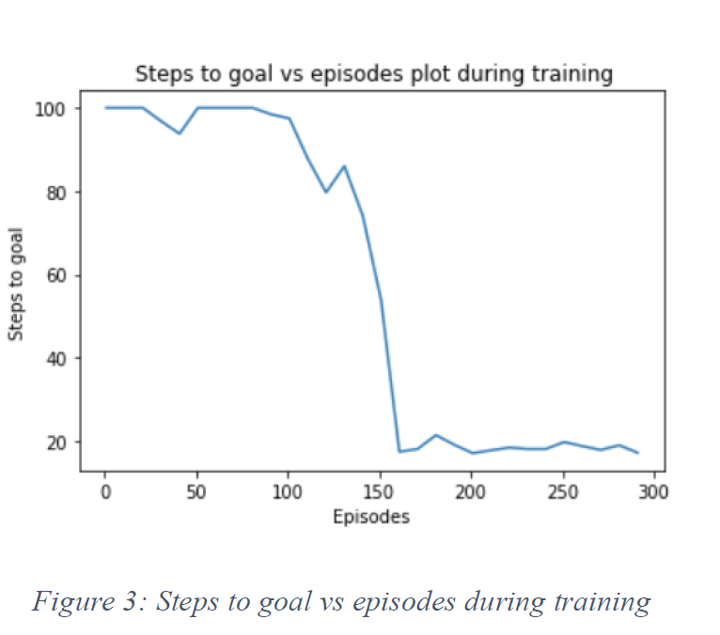
Running the Q learning algorithm
For the training we input the said values
No of episodes = 300
epsilon = 0.1 # The percentage of the timeframe were we take the best action. We are choosing the low number so that agent explores the entire training phase.
Discount factor or gamma = 0.9 We set the value to the maximum so that we get a maximum reward.
Learning rate or alpha = 0.9. We experiment with higher alpha.
From figure 3 We see that with the increase in the number of episodes there is decrease in the steps to reach the goal. Thereby understanding that the model is learning as the episodes process taking over its learn reward and using it as the learning for the next step of action and thereby finding the shortest path.

Slide 9
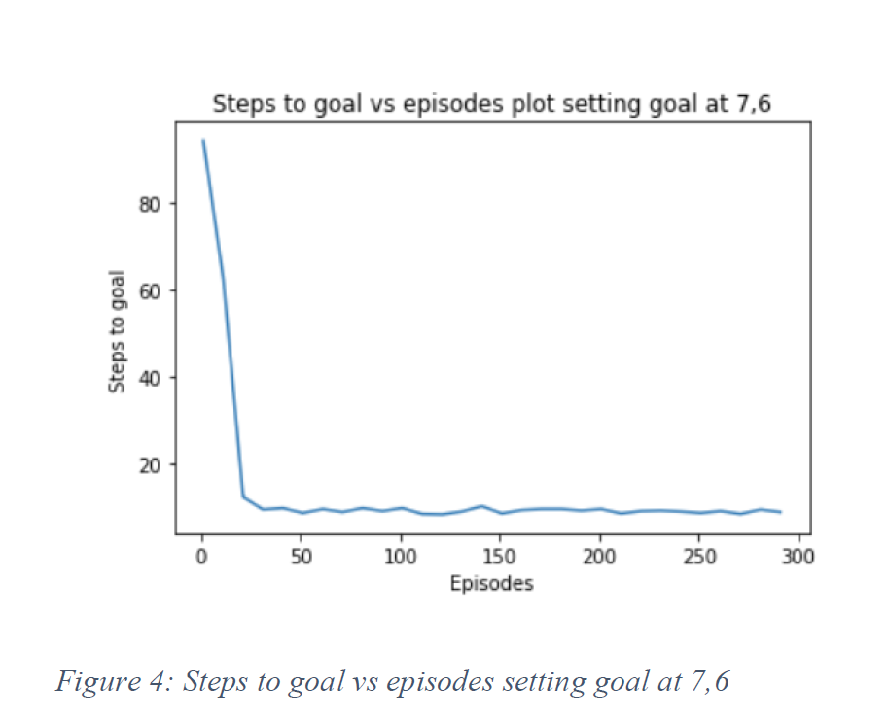
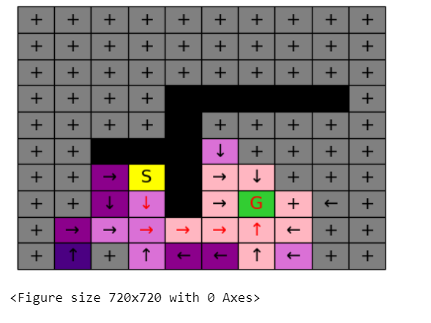
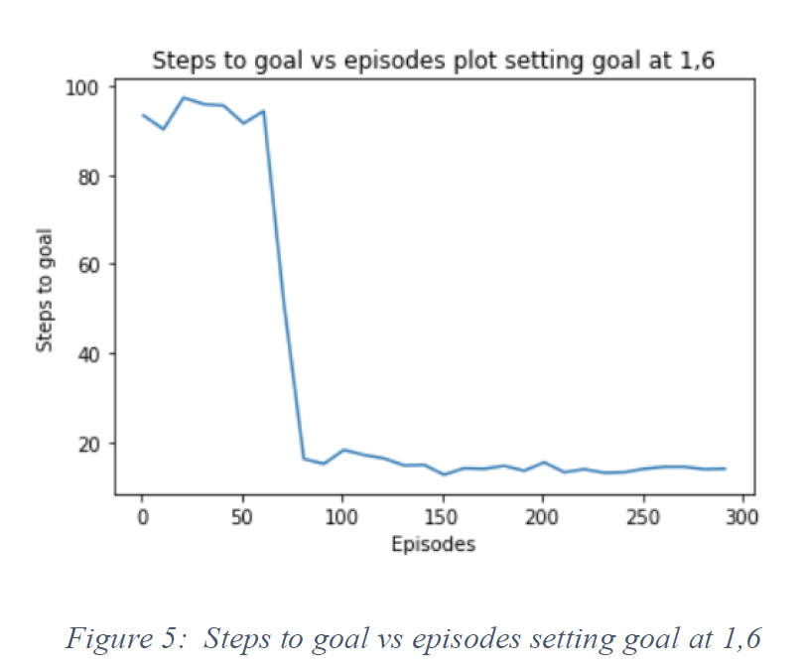
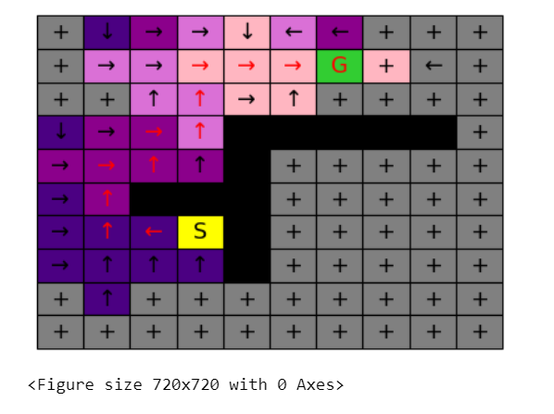
Running Q learning algorithm with different targets
From the same we see that it reaches the goal at it 300 episodes at less than 20 steps.
In the next step After we set up a different goal saying the goal is at 7,6
we understand that the steps to reach the goal is further decreased mainly to its earlier learnings also since the goal is significantly closer than the training set.
Setting up a tougher goal:
We set the goal to 1,6
In this for the figure 5 we understand that the time taken to reach is little longer than the previous goal as because of the longer path to reach the goal

Slide 10
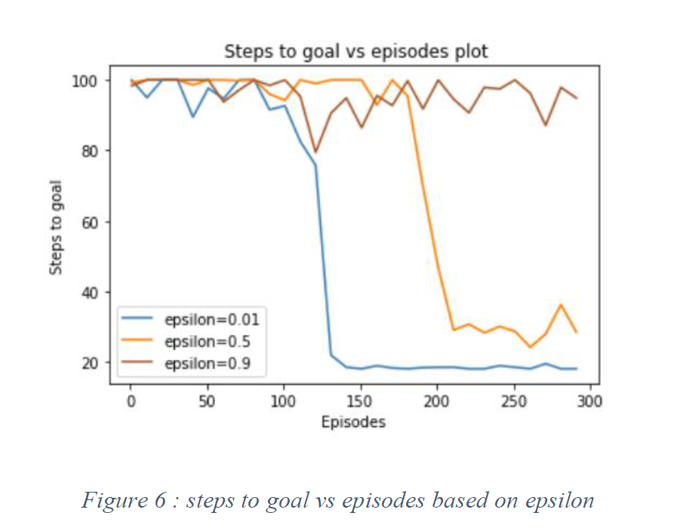
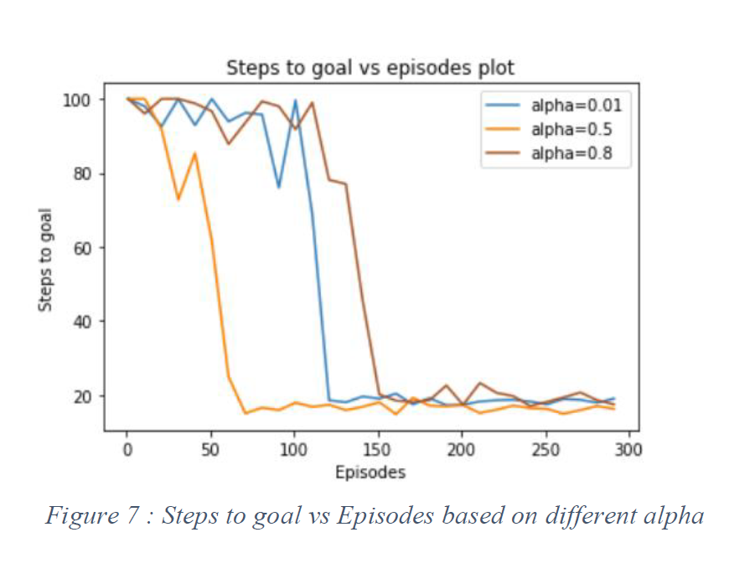
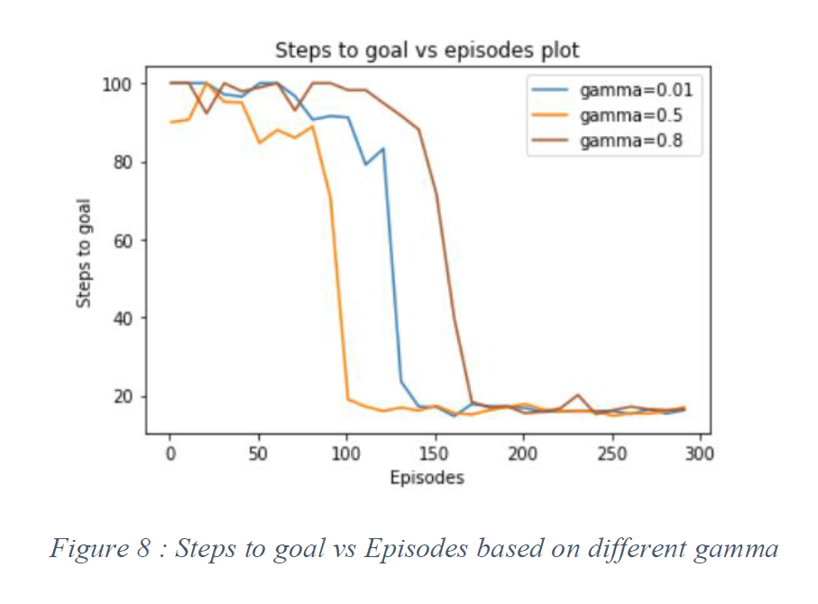
VI. ANALYSE THE RESULTS QUANTITATIVELY AND QUALITATIVELY
We know that increasing the epsilon values significantly make the algorithm greedy and makes the policy learn quicker by not so viable in the long run.
The higher amount of alpha signifies the learning can be occur at a faster phase
Setting the gamma to lower amount will make the reward to stand out continuing to the current rewards and gamma value higher will consider the rewards to be significantly good in the lingered term considering the strive to operating a higher amount of reward in the longer run.
Based on figure 6, 7 and 8 we can clearly understand that our experiment follows the literature. Increase in epsilon reduces the steps taken to reach the goal while the gamma value increase is significantly good rewards. The alpha phenomenon need to be noted that the lowers and higher value of alpha converges later while alpha = 0.5 converges earlier which suggests better scenario.

Slide 11
Deep Q learning
(i)DQN : In simpler words DQN replaces the Q table with a neural network. Instead of mapping a state action pair to a q-value a neural maps is put to action and q value pairs It uses 2 neural networks which have same architecture and different weights. With every N steps the writing form the main network are copied to the target area.
GYM environment is put to use in this scenario and use pf the cartpole game is made to implement the model
Considering the said both networks is done it thereby leads to a more stable learning processes and learns the algorithm effectively.
The main network wrights replace the target network weights every 100 steps.
In this scenario we are using the Cartpole problem and implement DQN
We are combing three different paper to do the same cart pole experiment in which each have chosen to do DQN, DDQN and Duelling separately and have chosen the same type of approach by various factors and we shall experiment with the same [3], [100, [11]

Slide 12
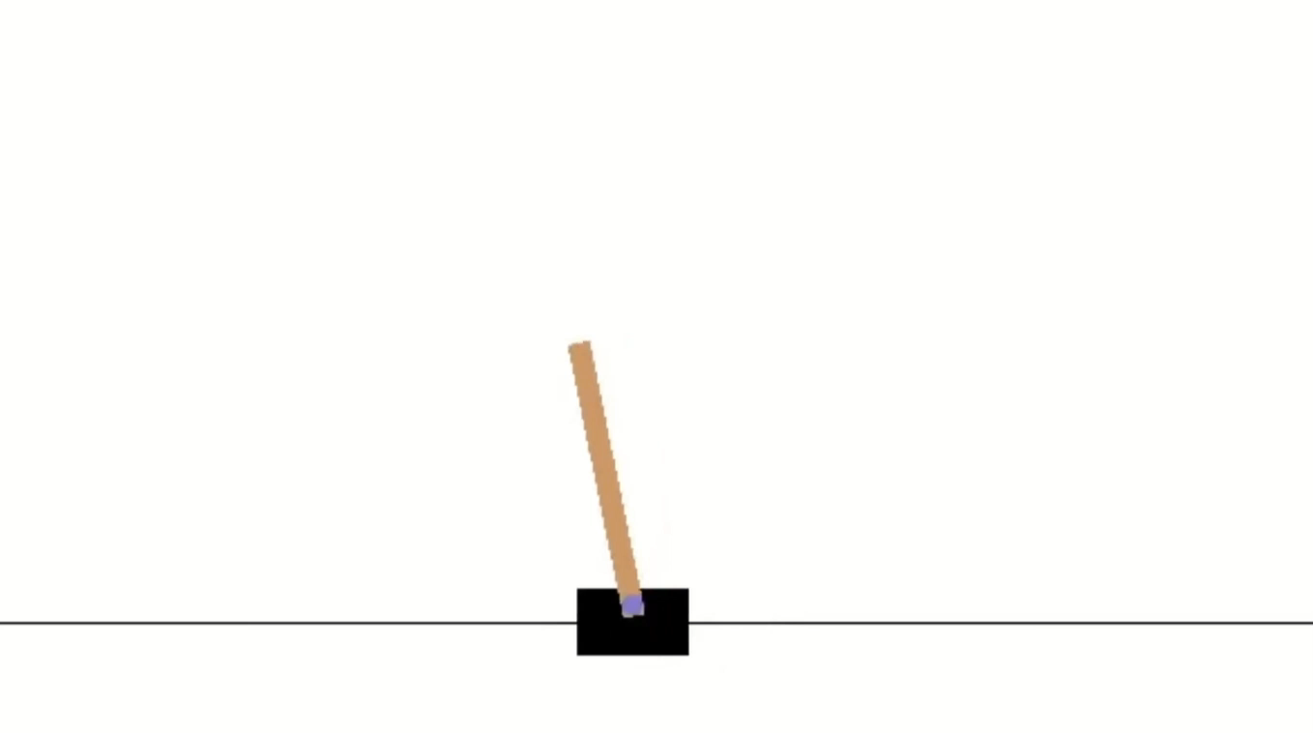
DQN Model
BATCH_SIZE = 32
LR = 0.01 # learning rate
EPSILON = 0.9 # greedy policy
GAMMA = 0.9 # reward discount
TARGET_REPLACE_ITER = 100 # target update frequency
MEMORY_CAPACITY = 2000

Slide 13
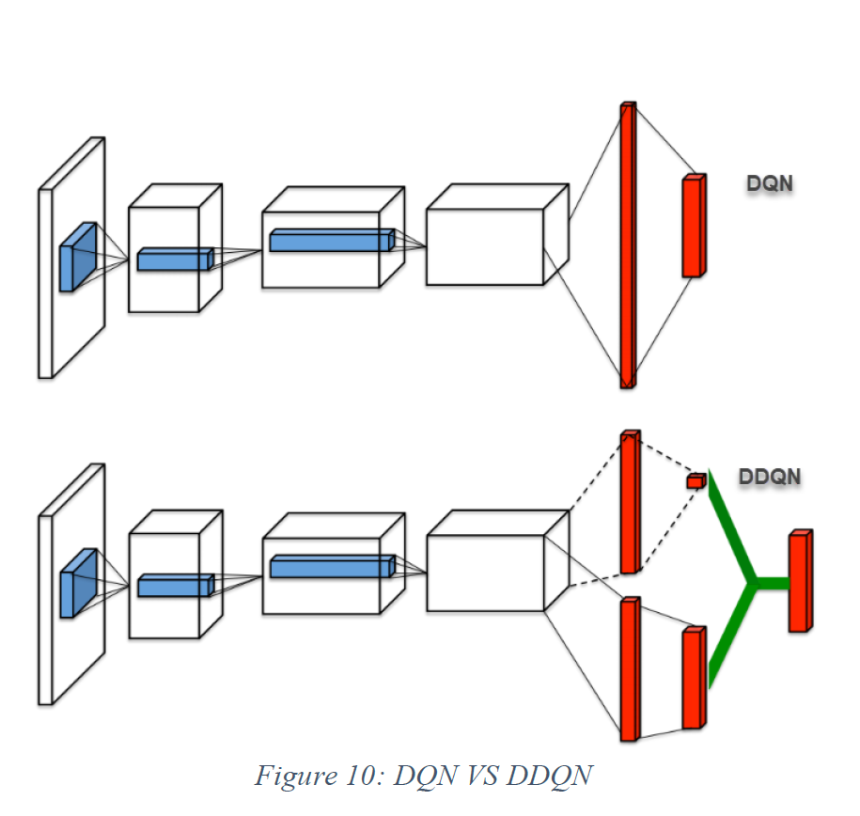
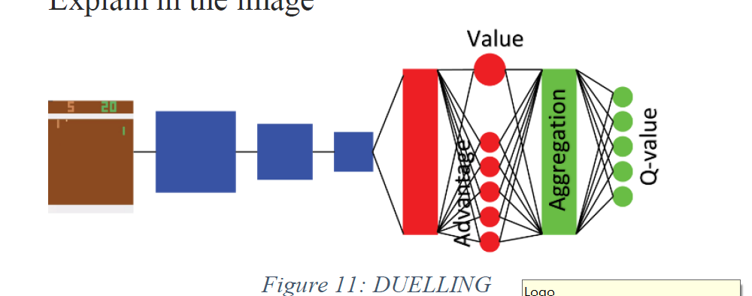
DDQN VS DUELLING
(ii)Double DQN: It utilises two identical neural networks models in which the first one learns during the process of the experience reply which is just a mere copy of the final episode in the initial model. The q value generated is the actual model. The q values is therefore computed with the second model Each neuron in the output will increase and increase till the difference between each output values is high.
Using the second model which is the copy of the main model of the last episode since the value different of the second model is lower than the main model we use the second model to attain q value therefore the process continues.|
(iii) Duelling DQN -The structure in the model is the difference between the Duelling and DDQN.
Duelling DQN uses a specialized Duelling Q Head in order to separate q to a A (advantage) stream and a V (value) stream Adding this type of structure to the network head allows the network to better differentiate actions from one another, and significantly improves the learning.
The formula is Q(s,a) = V(s) + A(S.a)

Slide 14
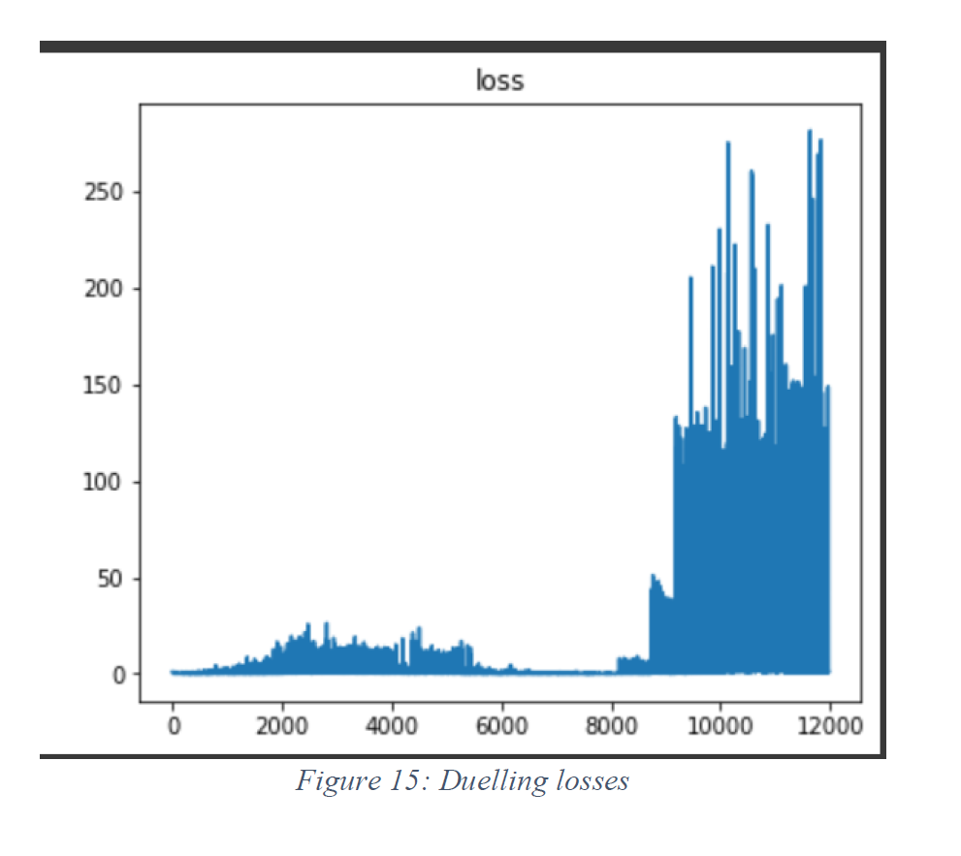
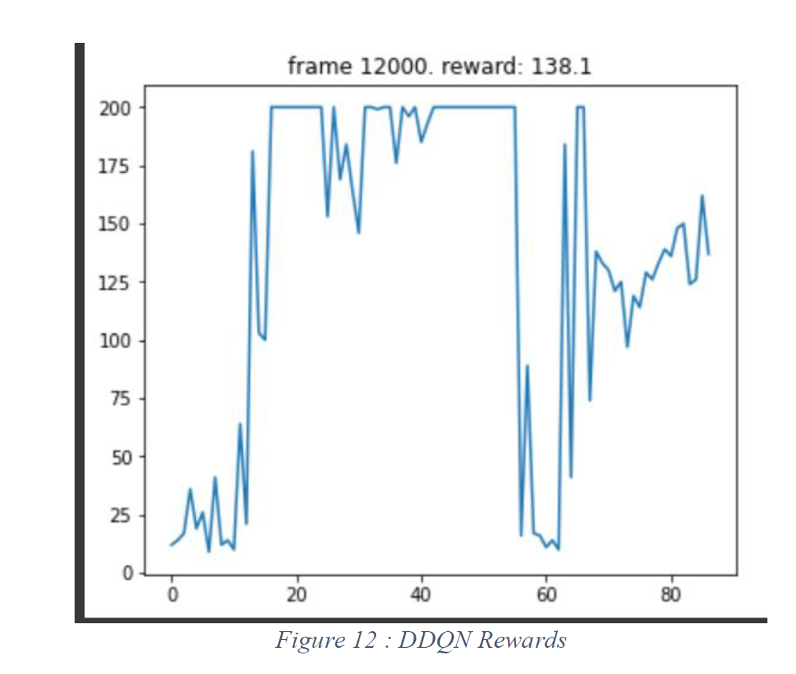
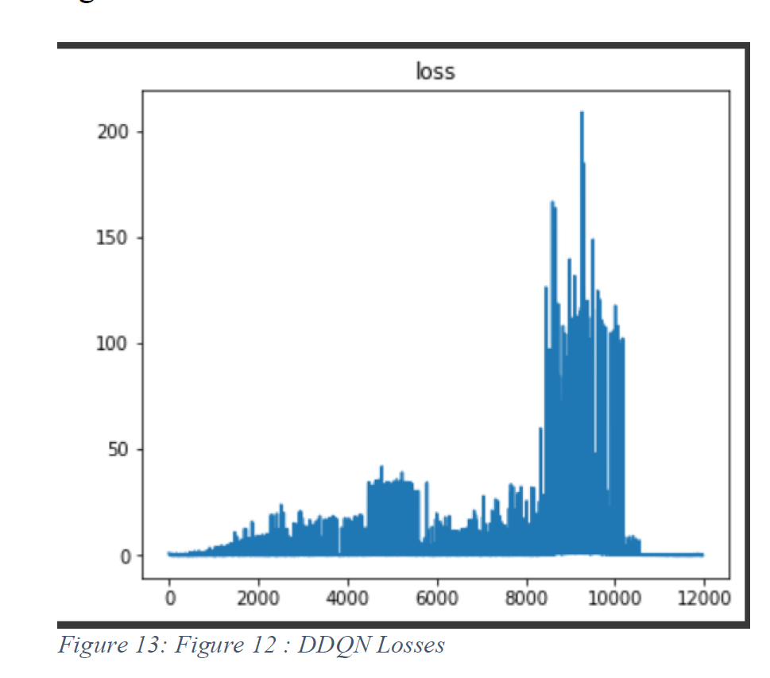
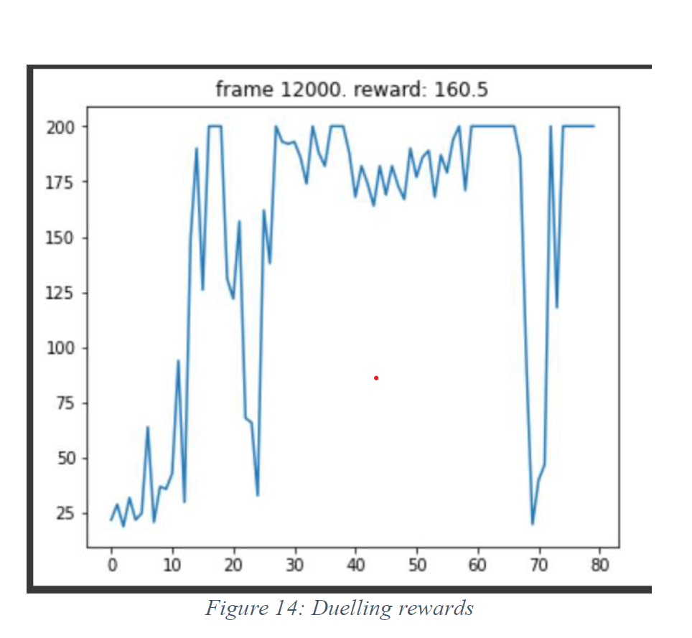
Analysing the results qualitative vs quantitively
Figure 12 explains The DDQN reward form a exponential path to reach the ward of 138 after the set of episodes run
The peak in the data set at 80 explained with the figure below
Figure 13 explain The loss is very heavily around the 80 therefor for the loss in reward at the end of episode 12000 loss is very heavily minimalized
Figure 14 explains The Duelling reward form a exponential path to reach the ward of 160 after the set of episodes run
The peak in the data set at 80 is similar to the DDQN but it continues till the almost very end. It is explain with the figure below
Figure 13 explain The loss is very heavily around the 80 but significantly continues till the end but the end of episode 12000 loss is very heavily minimalized
Therefore from the above performed experiments we can conclude that the duelling performs better than DQN and DDQN.

Slide 15
Atari environments
Atari is a third party owned game maker company by Nintendo Japan which collaborated with the Arcade learning environment (ALE) to creating
Atari environment which is significantly used fin the field of reinforcement learning for many contribution to produce heaps of games being developed on the reinforcement learning teaching techniques.
It has object oriented framework which supports to add agents and agents into the system and has d emulation core uncoupled from rending and sound generation
The programmer can easily extract games based on commands and experiment with over 100 ATARI 2600 games. Python support and Native Open AI gym support are significant features.
In this experiment we use the RL Lib
RL LIB is a open source library which supports and offers production level Reinforcement learning wrhile managing a very user friendly API. The amount of convolution layer building is not needed in RL LIB as the Algorithms are already pre coded into the system.

Slide 16
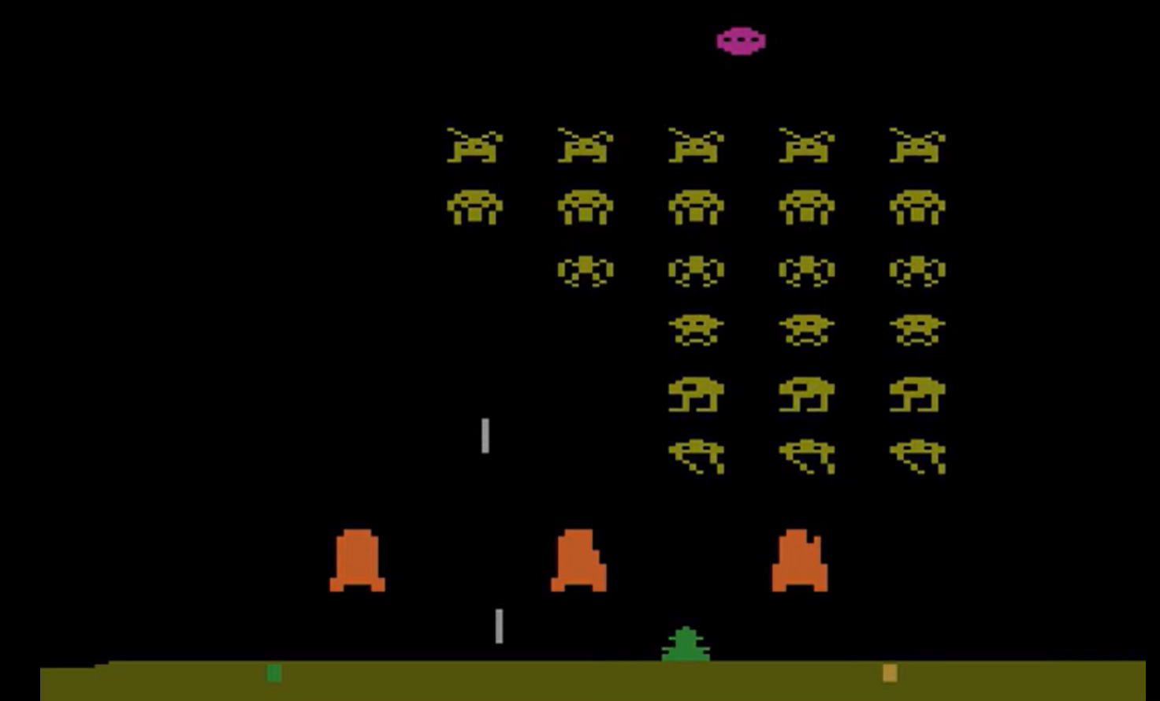
RL LIB ATARI
Algorithm : DQN DQN DUELLING AND DOUBLE DQN
Due to the limited run time on the google collab GPU the code as follows
config = {
"env" : "SpaceInvaders-ram-v0",
"dueling" : tune.grid_search([True,False]),
"double_q" : tune.grid_search([True,False]),
"lr" : tune.grid_search([0.1 , .3, 0.5]),
}

Slide 17
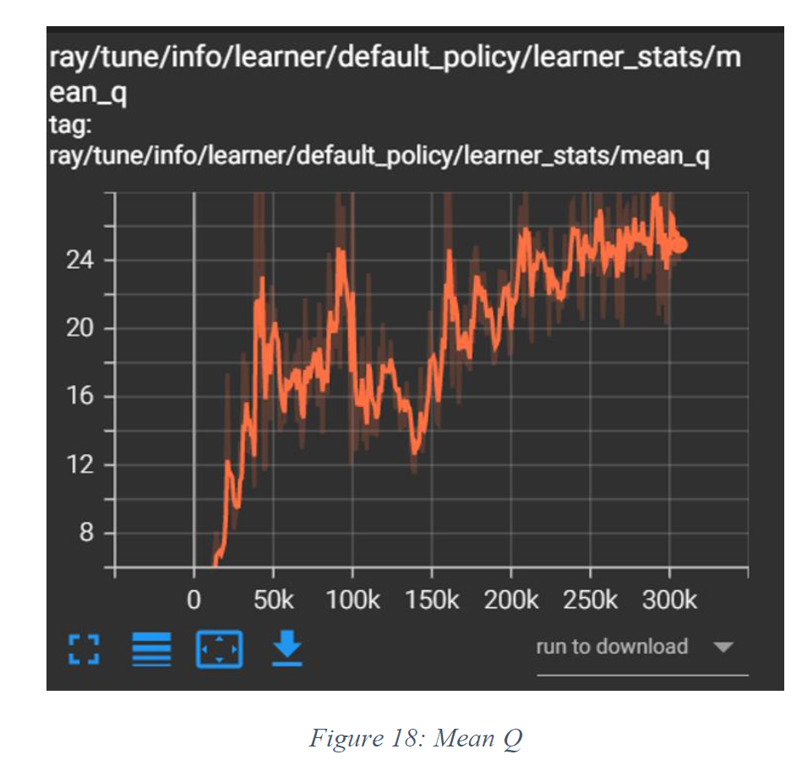
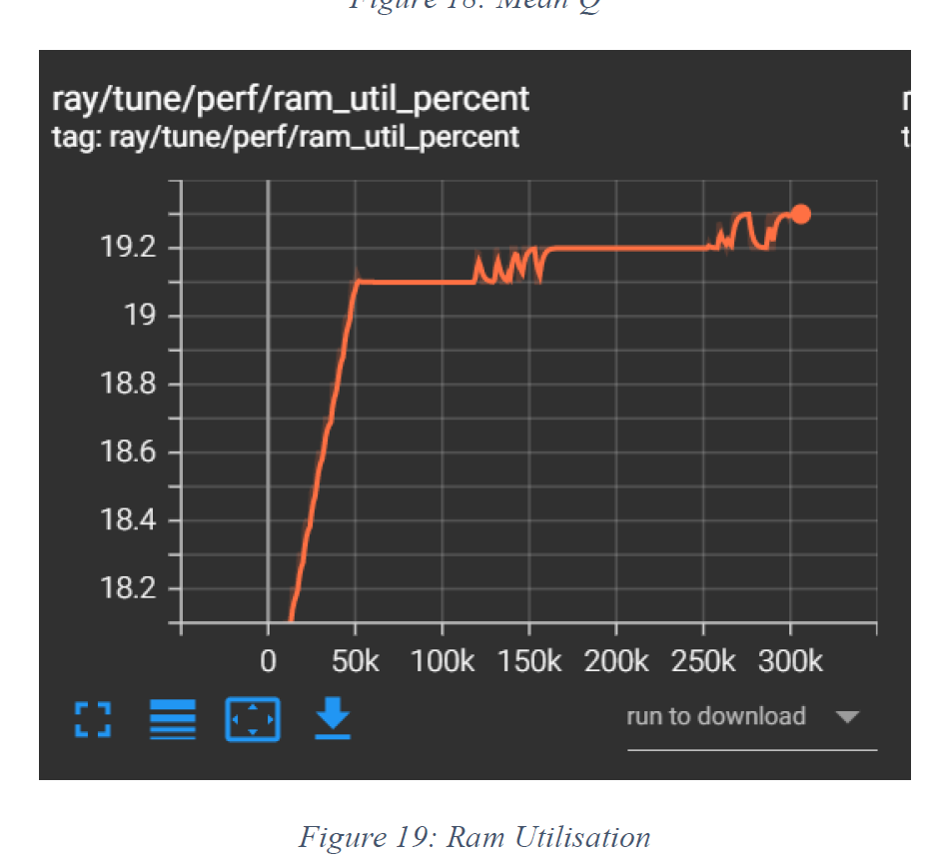
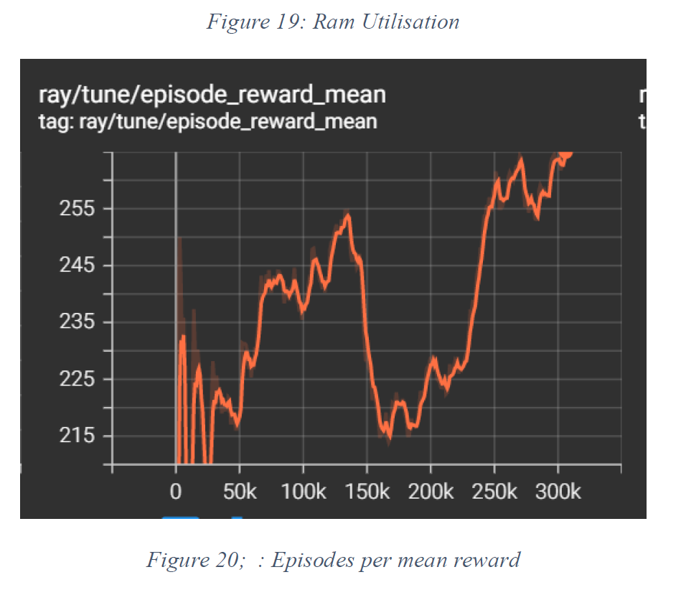
Analysing quantitatives and qualaititively
All the above mentioned chats prove that the at 300 episodes the experiment started working and the ram utilised has gone to maximum at 50K iteration.
The model run a space invaders can be experimented likely
If the google runtime had been present we could have been able to analyse different algorithms and learning and this is the next significant improvements required on this project.

Slide 18

PPO
What is PPO algorithm?
in Proximal Policy Optimization Algorithms. Proximal Policy Optimization, or PPO, is a policy gradient method for reinforcement learning. The motivation was to have an algorithm with the data efficiency and reliable performance of TRPO, while using only first-order optimization.
PPO is also another set of algorithms which is policy gradient method where the policy is updated explicitly.
We implement PPO on the Gym environment on the cartpole game using TensorFlow just to make changes to the path.
975 episodes

Slide 19

Thank you for watching

